Slide 1
Michael J. Fitzmaurice State Veterans Home Endowment Fund
For South Dakota’s Veterans

Slide 2
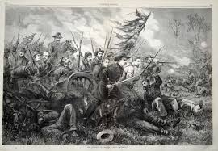
History
1886 Grand Army of the Republic (similar to today’s American Legion and VFW) created
Organized to promote the care and well-being of veterans, their families and their orphans
Notes:
After the Civil War, in 1886, a patriotic organization called the Grand Army of the Republic was created (similar to today’s American Legion and VFW). Its members were Civil War veterans and its purpose was to promote the care and well-being of veterans, their families and orphans.

Slide 3
History
1886 GAR convinced Territorial Legislature in Bismarck to construct soldiers home
Territorial Governor Church vetoed
1889 GAR brought new bill forward to the Territorial Legislature
Governor Church vetoed again
Legislature overrode veto and appropriated $45,000
Notes:
With great effort and persistence, in 1886, Dakotans convinced the territorial legislature in Bismarck to construct a soldier’s home. But, unexpectedly, territorial Governor Church vetoed it.
With even greater effort and persistence, the Dakota GAR answered Governor Church’s objections over an almost three year period and brought a new bill to the territorial Legislature in 1889. It passed, but again unexpectedly, Governor Church vetoed that bill.
The Dakota GAR didn’t give up. It became even more persistent and determined and the legislature finally overrode the veto and appropriated $45,000 to build the new home.

Slide 4
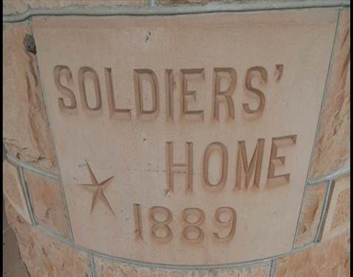
History
On November 11, 1889, (nine days after South Dakota became a state) the cornerstone of the first building was placed
Notes:
With that victory, the Dakota Territory became the first of all the territories to provide a home for their veterans.
On November 11, 1889, just nine days after South Dakota became a state, the cornerstone was placed at the home.

Slide 5
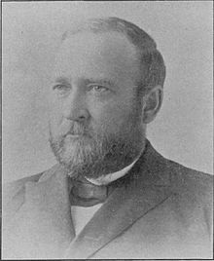
History
“It becomes our duty to provide suitably for the maintenance for those who have so richly earned the gratitude of a patriotic people.”
Governor Mellette
Notes:
Before construction was even completed, Governor Mellette addressed South Dakota’s first Legislative session in January, 1890, with the message that South Dakotans must also look to the future and make sure money is provided for the home’s maintenance and improvement.
The home opened in November, 1890, and the first ten residents were Civil War veterans.

Slide 6
Notes:
Postcard 1
Common Memorial Day Scene at the Veterans Home in the early years.

Slide 7
Notes:
Postcard 2
A memorial association was formed to raise money to erect a statue of General John Logan who instituted the tradition of Memorial Day in the United Sates. This postcard is of veterans gathered in front of the statute of General Logan in 1902.

Slide 8
Veterans Home Stats
WW II War Veterans - 20
Korean War Veterans - 25
Vietnam Veterans – 25
Peace Time Veterans – 20
Widows/Spouses - 23
Notes:
WW II War Veterans - 20
Korean War Veterans - 25
Vietnam Veterans – 25
Peace Time Veterans – 20
Widows/Spouses - 23

Slide 9
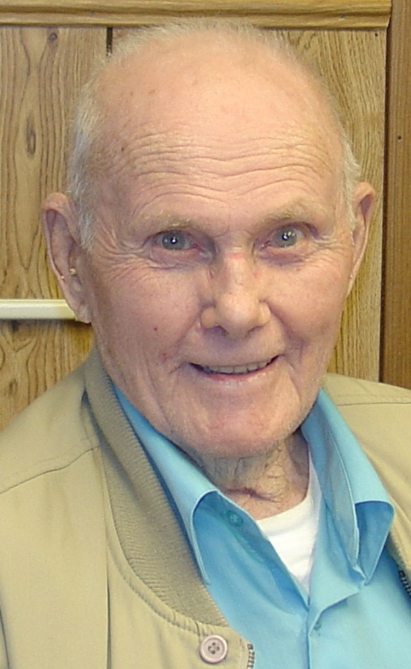
These are our Veterans
WW II Veteran
Flew 54 bomb missions against the Japanese
Recipient of two flying crosses
1949 Inducted into South Dakota Aviation Hall of Fame
Bazil “Bud” Murray
Notes:
Bazil “Bud” Murray
94-year old WW II Veteran
Flew 54 bomb missions against the Japanese
Recipient of two flying crosses - one for flying over 50 missions and the other one for the Yangtze mission
1949 Inducted into South Dakota Aviation Hall of Fame

Slide 10
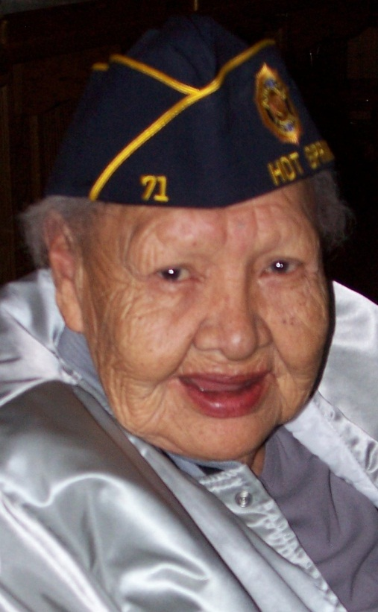
These are our Veterans
Native of Wounded Knee
Joined the Army in 1956
Served at Fort Riley from 1956-1958
Pearl Yellow Horse McLean
Notes:
Pearl Yellow Horse McLean
Native of Wounded Knee
Joined the Army in 1956
Served at Fort Riley from 1956-1958

Slide 11
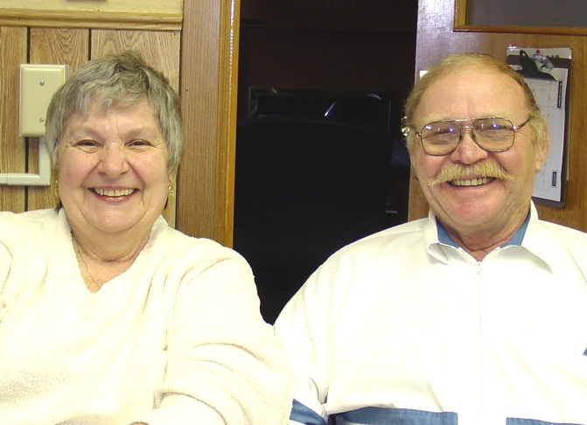
These are our Veterans
Korean War Veteran
Served U.S. Navy 1953 – 1955
U.S. Naval Air and served on the USS Philippine Sea, USS Midway and the USS Ticonderoga
Bernie and Dean Foucault
Notes:
Bernie and Dean Foucault
Korean War Veteran
Served U.S. Navy 1953 – 1955
U.S. Naval Air and served on the USS Philippine Sea, USS Midway and the USS Ticonderoga

Slide 12
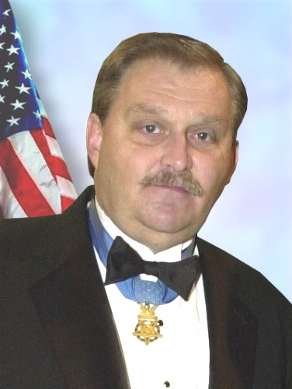
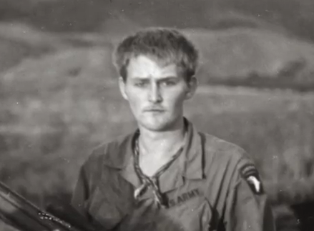
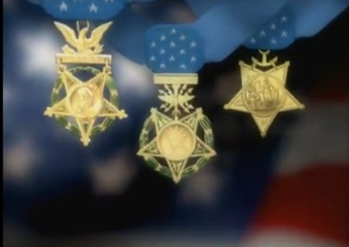
http://www.youtube.com/watch?v=uUw1-hfRccc
Notes:
Michael received the Congressional Medal of Honor for conspicuous gallantry and intrepidity of action at the risk of his life above and beyond the call of duty as a Specialist Four, United States Army, Troop D, 2nd Squadron, 17th Calvary, 101st Airborne Division at Khe Sanh, Republic of Vietnam, March 23, 1971.
The Fitzmaurice story needs to be told and I think Michael can do it more justice than I. We have a short four-minute clip that I would like to share with you.

Slide 13
Nothing Lasts Forever
Current Facility Built in 1889
Many Life/Safety Issues
Rising Maintenance Costs
Medicaid Eligibility
Bathrooms not ADA Accessible
Exposed Plumbing
Notes:
Current Facility Built in 1889
Many Life/Safety Issues
Rising Maintenance Costs
Medicaid Eligibility
Bathrooms not ADA Accessible
Exposed Plumbing

Slide 15
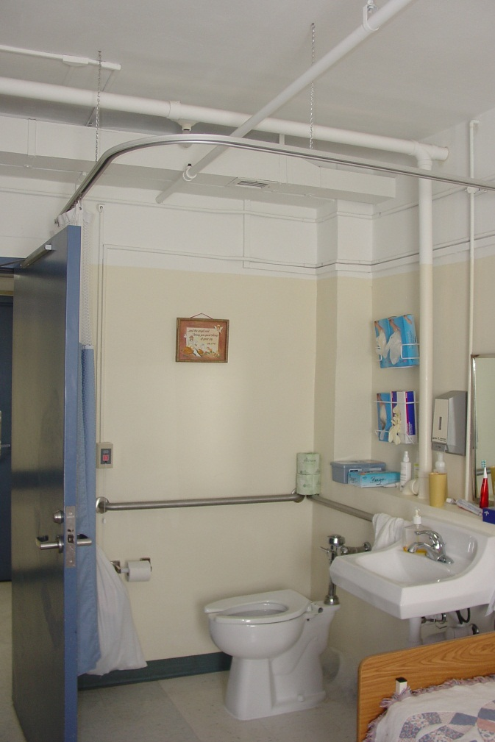

Slide 16
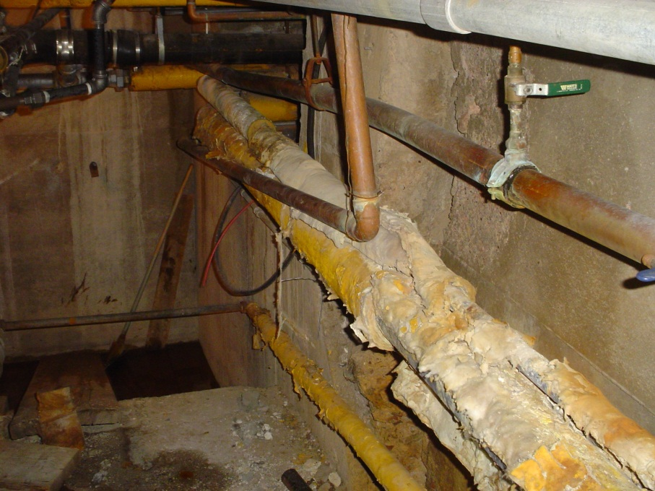

Slide 17
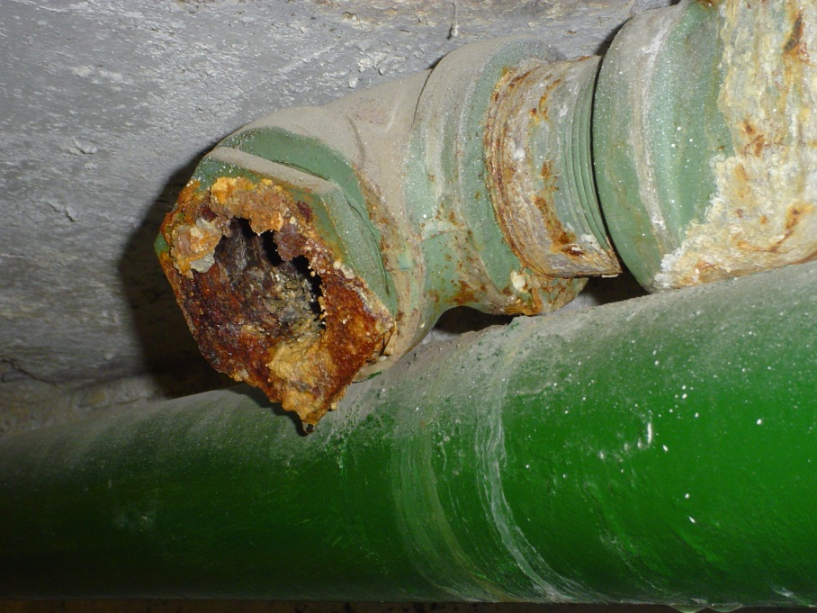

Slide 18
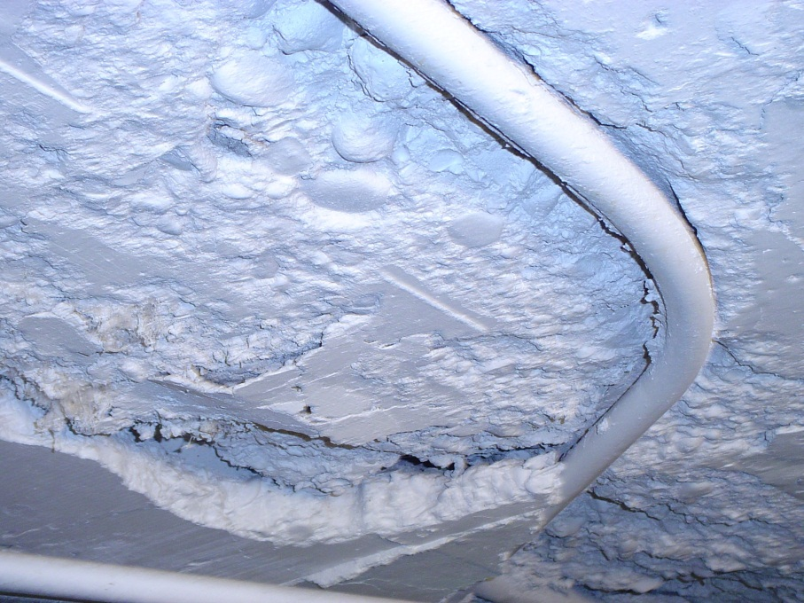

Slide 19
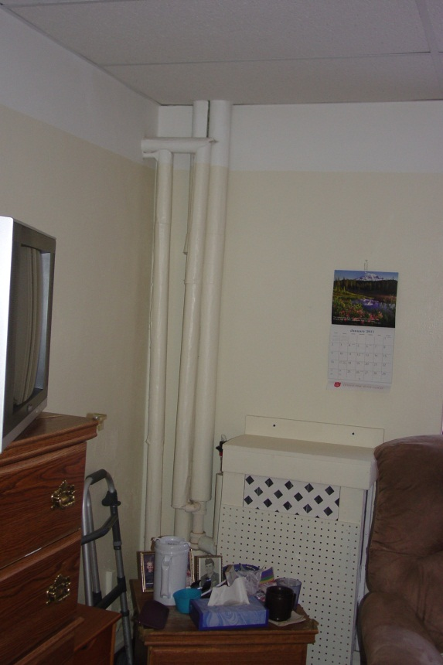

Slide 20
New State Home
2011 – Legislature approves construction of new veterans’ home at $34,600,000 (65% from VA federal construction grant and 35% from issuance of revenue bonds)
2012 VA requests change in design
2013 – Revised appropriation of $41 M
Notes:
2011 – Legislation secured to provide for the design, construction and equipping of the new veterans’ home at a cost of $34,600,000 (65% from VA federal construction grant and 35% from issuance of revenue bonds)
2012 VA changes design and construction requirements
2013 – Legislation revised to address changes in estimated costs - $41,271,214

Slide 21
New State Home
2013 Bids came in $8 million higher than budgeted, concern special session might be needed to avoid rebidding project
2013 Construction Manager at Risk hired (Scull Construction)
2013 Team within budget
Notes:
2013 Bids came in $8 million higher than budgeted, concern special session might be needed to avoid rebidding project
2013 Construction Manager at Risk hired (Scull Construction)
2013 Team within budget

Slide 22
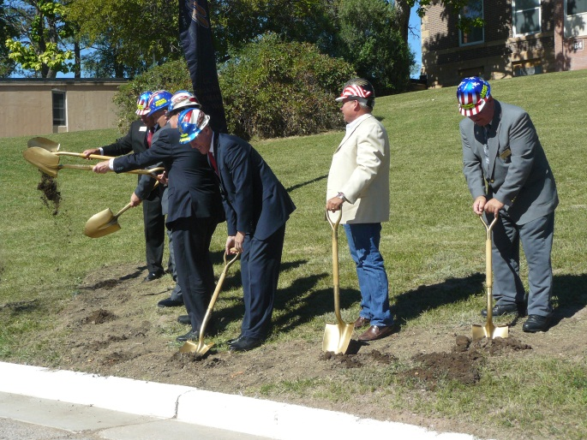
New State Home
Sept. 2013 – groundbreaking
Nov. 2013 –earthwork begins
We experienced setbacks --- but we didn’t give up!!
Notes:
September 2013 – groundbreaking was held
November 2013 – contractors begin mobilizing equipment and earthwork begins
2014 legislation secured to use a one-time appropriation of $16,365,044 instead of bonding the state’s share
We experienced setbacks --- but we didn’t give up!!

Slide 26
Notes:
New veterans home will be a 133,000 sq ft stacked two story building with a lower level walkout main entrance
100 bed facility – 52 skilled nursing beds on the main level and 48-non skilled on residential living beds on the upper level
Living spaces will be broken into eight neighborhoods housed in eight wings
Each neighborhood will include a living room, dining room, and kitchen area that will provide a home-like environment to the 12-13 residents

Slide 27
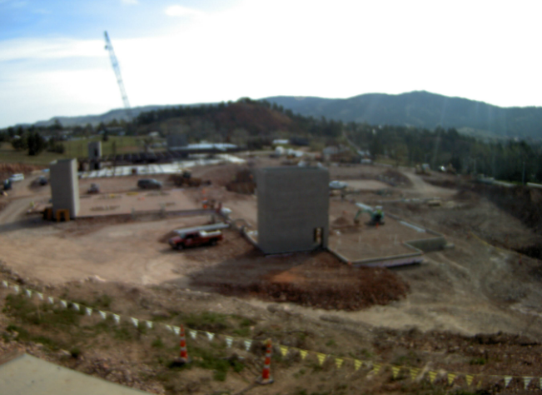
Notes:
Rock excavation is ongoing while the contractors work in other areas. The foundations and footings are moving along nicely and the perimeter of the building is beginning to take shape. The stair tower for the Northern most wings are almost complete and much of the underground plumbing in this area is done as well.

Slide 28
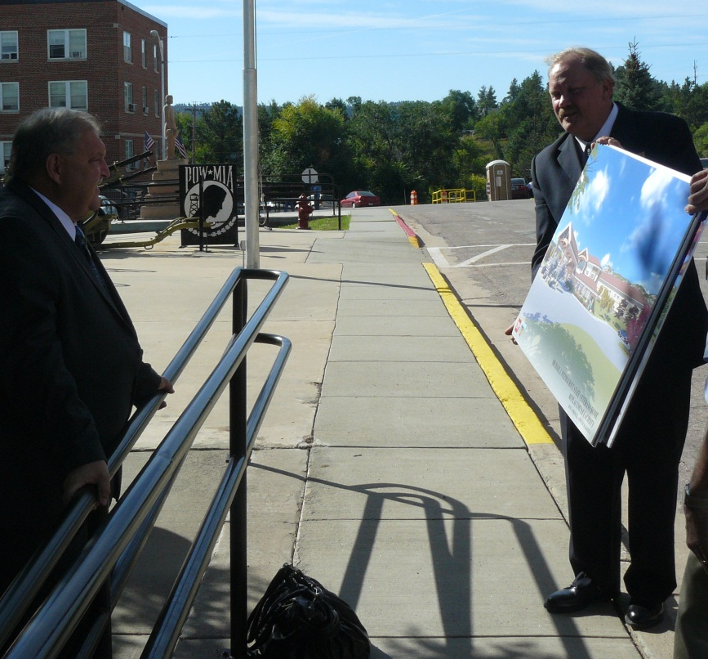
Vision
To provide assistance and support to South Dakota’s veterans and their spouses residing at the Michael J. Fitzmaurice State Veterans Home
Notes:
To provide assistance and support to South Dakota’s veterans and their spouses residing at the Michael J. Fitzmaurice State Veterans Home

Slide 29
Michael J. Fitzmaurice State Veterans Home Endowment
Like Governor Mellette in 1890, I too worry about the future of the veterans in our state home ---
“How can we make sure that our veterans will have what they need 25, 50 and 100 years from now?”
“Will there be support and funding in future years?”
“Will there be funds to ensure they can travel, hunt, fish and enjoy life?”
Notes:
Like Governor Mellette in 1890, I too worry about the future of the veterans in our state home ---
“How can we make sure that our veterans will have what they need 25, 50 and 100 years from now?”
“Will there be support and funding in future years?”
“Will there be funds to ensure they can travel, hunt, fish and enjoy life?”

Slide 30
Michael J. Fitzmaurice State Veterans Home Endowment
Fear of reduced funds from the federal government
Veterans healthcare needs continue to grow
Notes:
Federal deficits have resulted in pressure to reduce government spending. The pressure to reduce budgets for federal agencies, while the veteran population is aging rapidly and presenting different health care needs, has resulted in significant challenges for federal and state governments. As a result, veterans will continue to need more – not fewer -- resources at a time when the resources to support those needs are becoming more scarce

Slide 31
Near Term Needs
Robotics and new medical equipment ($1,000,000)
Columbarium ($150,000)
Veterans Memorial Garden ($200,000)
Veterans and contributors recognition ($300,000)
Notes:
Here are some items we would used funds for in the near future:
Robotics and new medical equipment ($1,000,000)
Columbarium ($150,000)
Veterans Memorial Garden ($200,000)
Veterans and contributors recognition ($300,000)

Slide 32
Michael J. Fitzmaurice State Veterans Home Endowment
Income for activities, programs, and equipment to enhance the quality of life for the residents
Utilize South Dakota Community Foundation
Notes:
Investment earnings could be used for activities, programs, and equipment to enhance the quality of life for the residents of the Michael J. Fitzmaurice Veterans Home
Utilize South Dakota Community Foundation

Slide 33
Endowment Team
Major General Ray Carpenter
SDDVA Secretary Larry Zimmerman
SDDVA PIO Audry Ricketts
Notes:
Endowment Team
Ray Carpenter
General Carpenter began his military career by joining the South Dakota Army National Guard in 1967. A short time later he would join the Navy, where he learned Vietnamese before being assigned in Danang, South Vietnam. Upon completion of his Navy service, General Carpenter returned to the South Dakota Army National Guard, where he received his commission in 1974.
General Carpenter has commanded Soldiers from his commissioning through his time as a colonel. In 1993 he became the executive officer of the 5,000-plus Soldier Task Force Rushmore, which was sent to Panama on a humanitarian mission to build 27 kilometers of road and rebuild 10 schools and 14 clinics.
During his 29-month tenure as acting director of the Army National Guard, General Carpenter was responsible for executing a budget of nearly $40 billion dollars, procurement of over 300,000 units of equipment, the recruitment and training of 100,000 Soldiers, and the mobilization and deployment of 80,000 Soldiers. In addition, Army National Guard Soldiers were deployed to support the surge in Afghanistan and the withdrawal from Iraq; they also provided assistance in the aftermath of Hurricane Irene, the Joplin Tornado and the BP Deep Water Horizon Gulf oil spill. General Carpenter retired in 2011 after having served over 44 years in uniform.
General Carpenter has received numerous decorations for his exemplary military service, including the Distinguished Service Medal, Legion of Merit with Bronze Oak Leaf Cluster, Meritorious Service Medal with Silver Oak Leaf Cluster and a number of South Dakota Army National Guard medals and citations. For his support of the Army Corps of Engineers, General Carpenter was awarded the U.S. Army Engineer Association Silver de Fleury Medal.
Larry Zimmerman
Larry D. Zimmerman became the first Secretary of the SD Department of Veterans Affairs Secretary effective January 9, 2013. As the Secretary of Veterans Affairs, Zimmerman serves over seventy thousand veterans within the borders of South Dakota. Zimmerman’s vision, mission, and focus are to be the voice for South Dakota’s veterans.
Secretary Zimmerman attended high school in Belle Fourche, SD his hometown. He graduated from Ashford University in Clinton, IA, with a Bachelors degree in Business and Organizational Management. His military education includes many schools including the Sergeants Major Academy.
Prior to being selected as the Secretary of Veterans Affairs in South Dakota he served as the State Command Sergeant Major, he also served as Postmaster in Spearfish, Pierre and Sturgis. His career in the U.S. Postal Service spanned 35 years and he held many positions in western South Dakota. Secretary Zimmerman retired from the Post Office on February 1, 2009.
Zimmerman served 29 years in the South Dakota National Guard retiring in January of 2013. He completed a tour in Afghanistan (OEF) as the Operations SGM for the nine Northern provinces in that country, and before that was the CSM in both the 109th RSG in Rapid City, SD and the 109th En Bn in Sturgis, and the Regional Training Institute at Ft Meade along with numerous other positions within the Army Guard. Zimmerman was Active Duty Army from 1973-1976 in the 4th Infantry Division at Ft Carson, CO.
Secretary Zimmerman is married to Dyann and they have three daughters, Misty, Crisha, and Lanna and five grandchildren.
Secretary Zimmerman has received numerous decorations for his exemplary military service, including the Legion of Merit, Bronze Star,Meritorious Service Medal,Afghanistan Campaign Medal w/star, Army Commendation Medal w/1 OLC, Army Achievement Medal w/ 1 OLC,
Army Good Conduct Medal,Reserve Component Achievement Medal 5th Award, National Defense 3rd Award,Non Art 5 NATO ISAF Medal, Global War on Terrorism Service Medal,NCO Professional Development Ribbon w/4, Army Service Ribbon, Overseas Service Ribbon, Armed Forces Reserve Medal w/ M device and 20 Year, SD Distinguished Service Award, SD Recruiting Ribbon, SD Service Medal and SD Desert Storm Ribbon.
Audry Ricketts
Audry Ricketts was named Public Information Officer (PIO) for the South Dakota Department of Veterans Affairs in, 2009. Prior to joining the SDDVA team Audry dedicated 25 years of her working career to the South Dakota Rural Electric Association. During her tenure with the electric cooperatives Audry was devoted to unifying, promoting and protecting the interests of member electric cooperatives in South Dakota. She was the chief spokesperson for the state's 31 consumer-owned, electric cooperatives, and represented the interests of electric cooperatives and their consumers before Congress, the South Dakota Legislature and state agencies.

Slide 34
2014 Endowment Timeline
$500 Plate Dinner – 2 Medal of Honor Guests
Conduct Follow Up Meetings with Guests at Gala
August 2014
Kick Off Gala at Mansion
May-July 2014
May 2014

Slide 35
2015 Endowment Timeline
Construction Complete
Host Events in 100 Communities
November 2015
September 2014 – February 2015

Slide 36
2016 Endowment Timeline
Open House
Pre-Open House/Tour of Cemetery for Major Donors
May 2016
April 2016

Slide 37
2018 Endowment Timeline
First Year to Tap Endowment
2018

Slide 38
Gift Level | # of Gifts | # of Prospects | Amount
$500,000 | 1 | 3 | $500,000
$250,000 | 2 | 6 | $500,000
$100,000 | 4 | 12 | $400,000
$50,000 | 8 | 24 | $400,000
$25,000 | 16 | 48 | $400,000
$10,000 | 32 | 96 | $320,000
$5,000 | 64 | 192 | $320,000
$1,000 | 160 | 480 | $160,000
Total Raised |  |  | $3,000,000

Slide 39
Thank you for your continued support of South Dakota
Notes:
During the summer months General Carpenter will be contacting attendees and friends of our veterans to determine interest of support.

